Slide 1

CS 533 INTRO TO DATA SCIENCE
Michael Ekstrand

Slide 2
REPLICATION, BIAS, AND VARIANCE

Slide 3

Learning Outcomes
Reason about repeated training on different samples
Introduce the bias-variance tradeoff
Photo by Nick Reynolds on Unsplash

Slide 4
Replication
Remember bootstrapping and simulation?
Repeated samples
Compute expectation, variance, etc. of parameters
What about prediction?

Slide 5
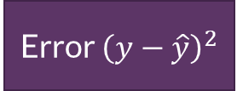






Test Error
Expected Test Error $E_{x,y}\left[{\left(y−M_{d}\left(x\right)\right)}^{2}\right]$
Population
Test Point $x, y$
Error ${\left(y−\hat{y}\right)}^{2}$
Training Data $D$
Model $M_{D}$
Prediction $\hat{y}=M_{d}(x)$

Slide 6
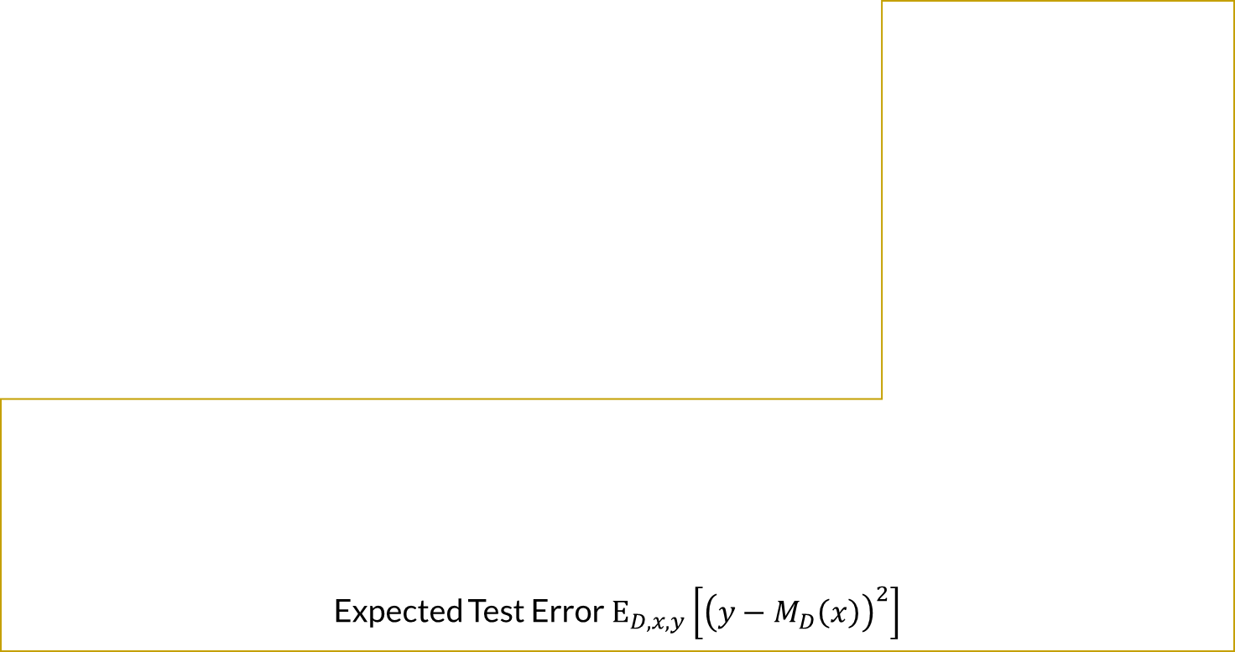
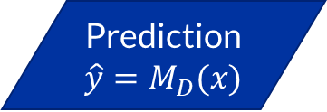

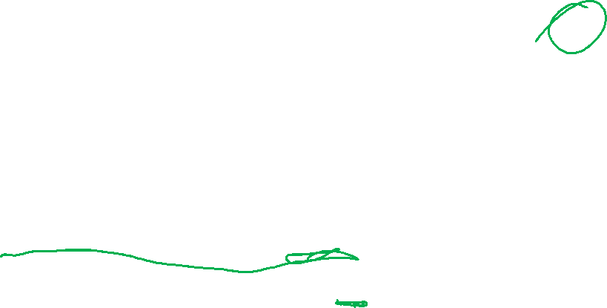
Test Error (Repeated Training)
Expected Test Error $E_{D,x,y}\left[{\left(y−M_{D}\left(x\right)\right)}^{2}\right]$
Population
Test Point $x, y$
Error ${\left(y−\hat{y}\right)}^{2}$
Training Data $D$
Model $M_{D}$
Prediction $\hat{y}=M_{D}(x)$

Slide 7
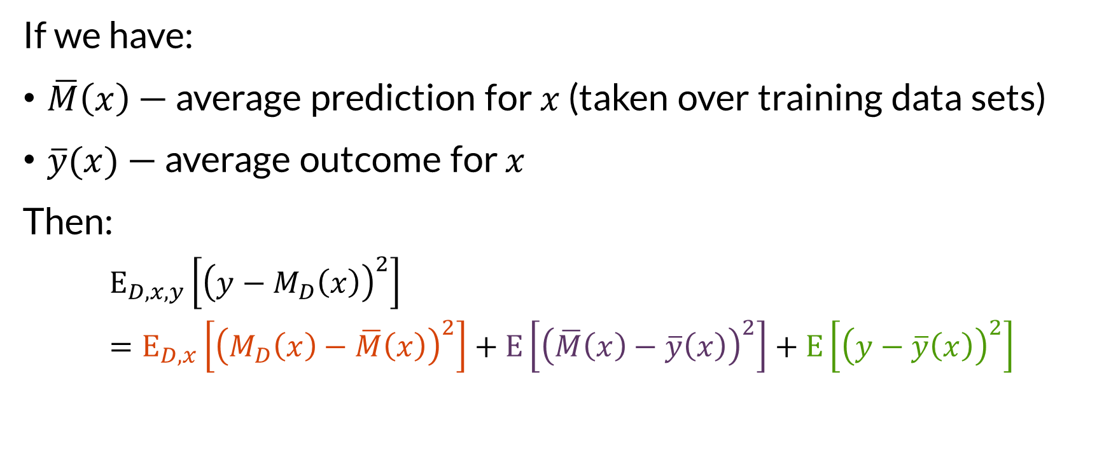
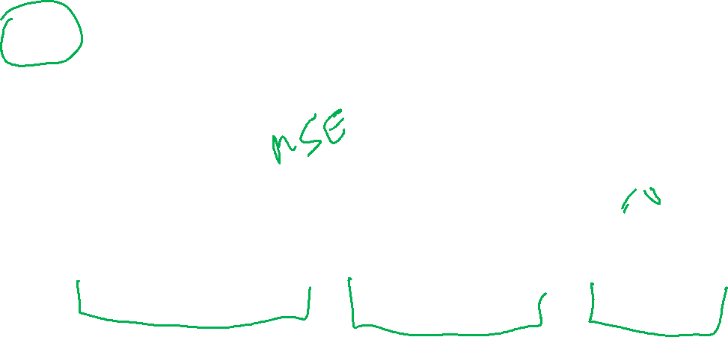
Bias-Variance Tradeoff
If we have:
$\overline{M}\left(x\right)$ — average prediction for $x$ (taken over training data sets)
$\overline{y}(x)$ — average outcome for $x$
Then:
$$E_{D,x,y}\left[{\left(y−M_{D}\left(x\right)\right)}^{2}\right]=E_{D,x}\left[{\left(M_{D}\left(x\right)−\overline{M}\left(x\right)\right)}^{2}\right]+E\left[{\left(\overline{M}\left(x\right)−\overline{y}\left(x\right)\right)}^{2}\right]+E\left[{\left(y−\overline{y}\left(x\right)\right)}^{2}\right]$$
Variance
Bias²
Noise

Slide 8

Wrapping Up
Expected test error is the error we expect from predicting new, unobserved data points.
When training from samples, expected error can be decomposed into model bias, model variance, and noise.
Photo by Mitchell Luo on Unsplash

